Slide 1

Data Normalization Using Python & Power BI
This presentation explores the power of data normalization using Python and Power BI. Learn to transform raw data into meaningful insights through a step-by-step process, enhancing analysis and visualization.

Slide 2
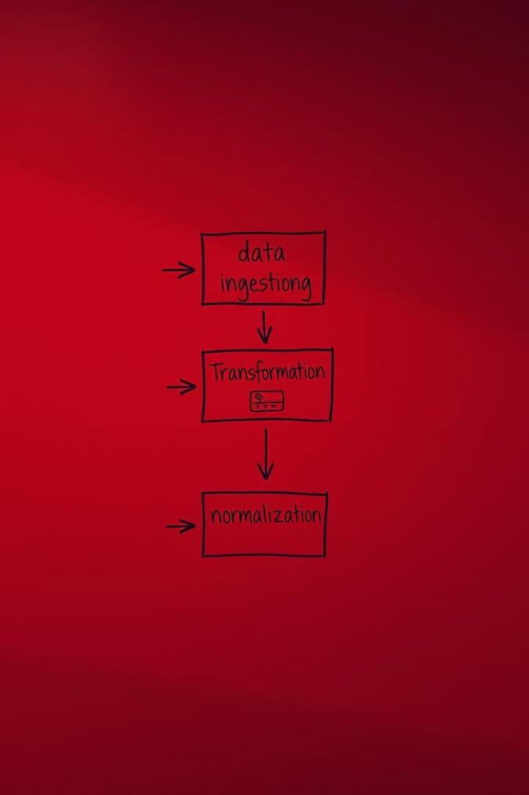
Presentation Objectives
1
1. Understand Normalization
2
2. Python Preprocessing
Normalization scales numerical data into a range (usually between 0 and 1) for better comparisons.
Walk through the Python preprocessing step for data preparation.
3
3. Power BI DAX Expressions
4
4. Visualize Insights
Explore Power BI's DAX expressions for further normalization.
Learn how to visualize normalized data insights using Power BI charts.

Slide 3
What is Normalization?
Definition
Why Normalize Data?
Normalization scales numerical data into a range (usually between 0 and 1) for better comparisons.
Comparability across financial time series data. Handle large differences in ranges between metrics. Scale data for predictive models.

Slide 4
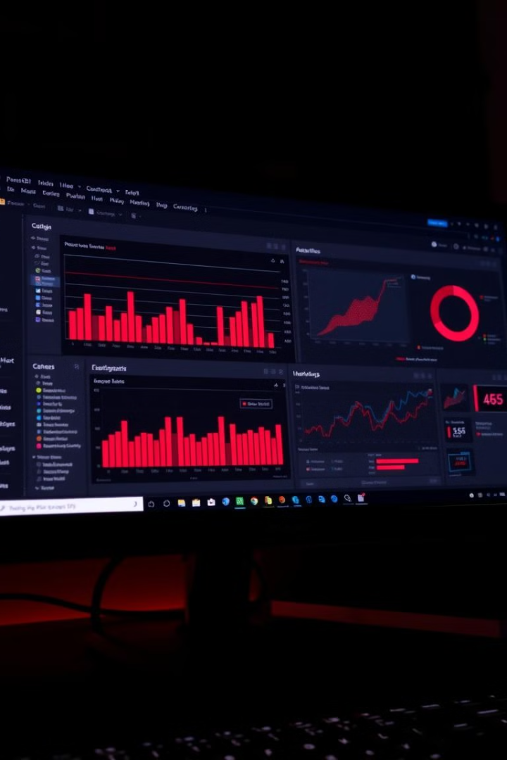


Tools & Technologies
Python with Pandas
Power BI
Data preprocessing and normalization logic.
Visualization and reporting using DAX.

Slide 5

Workflow Overview
DAX Logic (Normalization in Power BI)
Python Data Preparation
Read data from CSVs or databases, preprocess and normalize data.
Add further logic or adjust normalized calculations in Power BI.
1
2
3
4
Load into Power BI
Visualize in Power BI
Import preprocessed data into Power BI for further analysis.
Create interactive insights through charts/graphs using visualization tools.

Slide 6

Python Data Processing & Normalization
import pandas as pd
import matplotlib.pyplot as plt
# Load dataset
data = pd.read_csv('google_data.csv')
# Perform normalization logic
data['Normalized_Volume'] = (data['volume'] - data['volume'].min()) / (data['volume'].max() - data['volume'].min())
# Visualize data trends
plt.figure(figsize=(12, 6))
plt.plot(data['Date'], data['volume'], label='Volume')
plt.plot(data['Date'], data['Normalized_Volume'], label='Normalized Volume')
plt.legend()
plt.show()

Slide 7
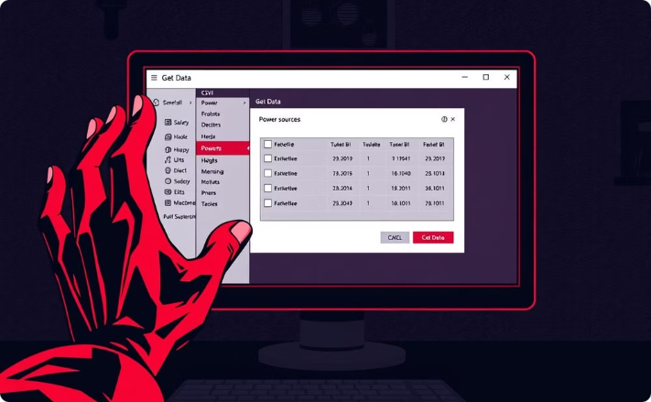
Data Import into Power BI
Preprocessed data saved as normalized_data.csv.
Load Data in Power BI: Navigate to Home > Get Data > CSV. Import data from the CSV file preprocessed using Python.

Slide 8

DAX Expression for Normalization
Normalized Price = VAR MinPrice = CALCULATE(MIN('google XLSX'[Low])) VAR MaxPrice = CALCULATE(MAX('google XLSX'[High])) RETURN DIVIDE('google XLSX'[volume] - MinPrice, MaxPrice - MinPrice)

Slide 9
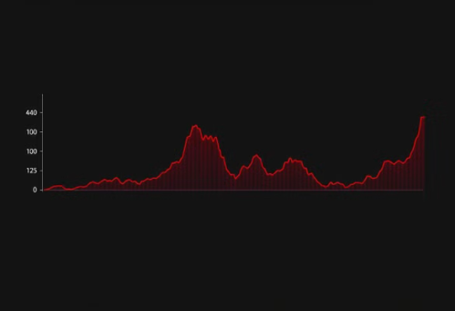
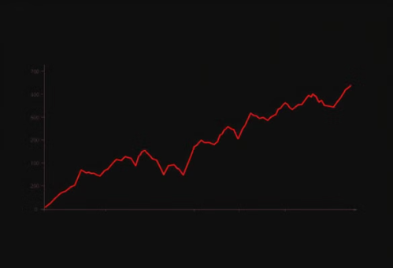
Visualize Trends

Slide 10

Python + Power BI Integration Benefits
Leverage Python's Power
Interactive Insights
Utilize Python's advanced data manipulation capabilities.
Visualize insights interactively with Power BI's DAX & visualization features.
Rapid Insights
Achieve insights quickly and iteratively.

